Slide 1

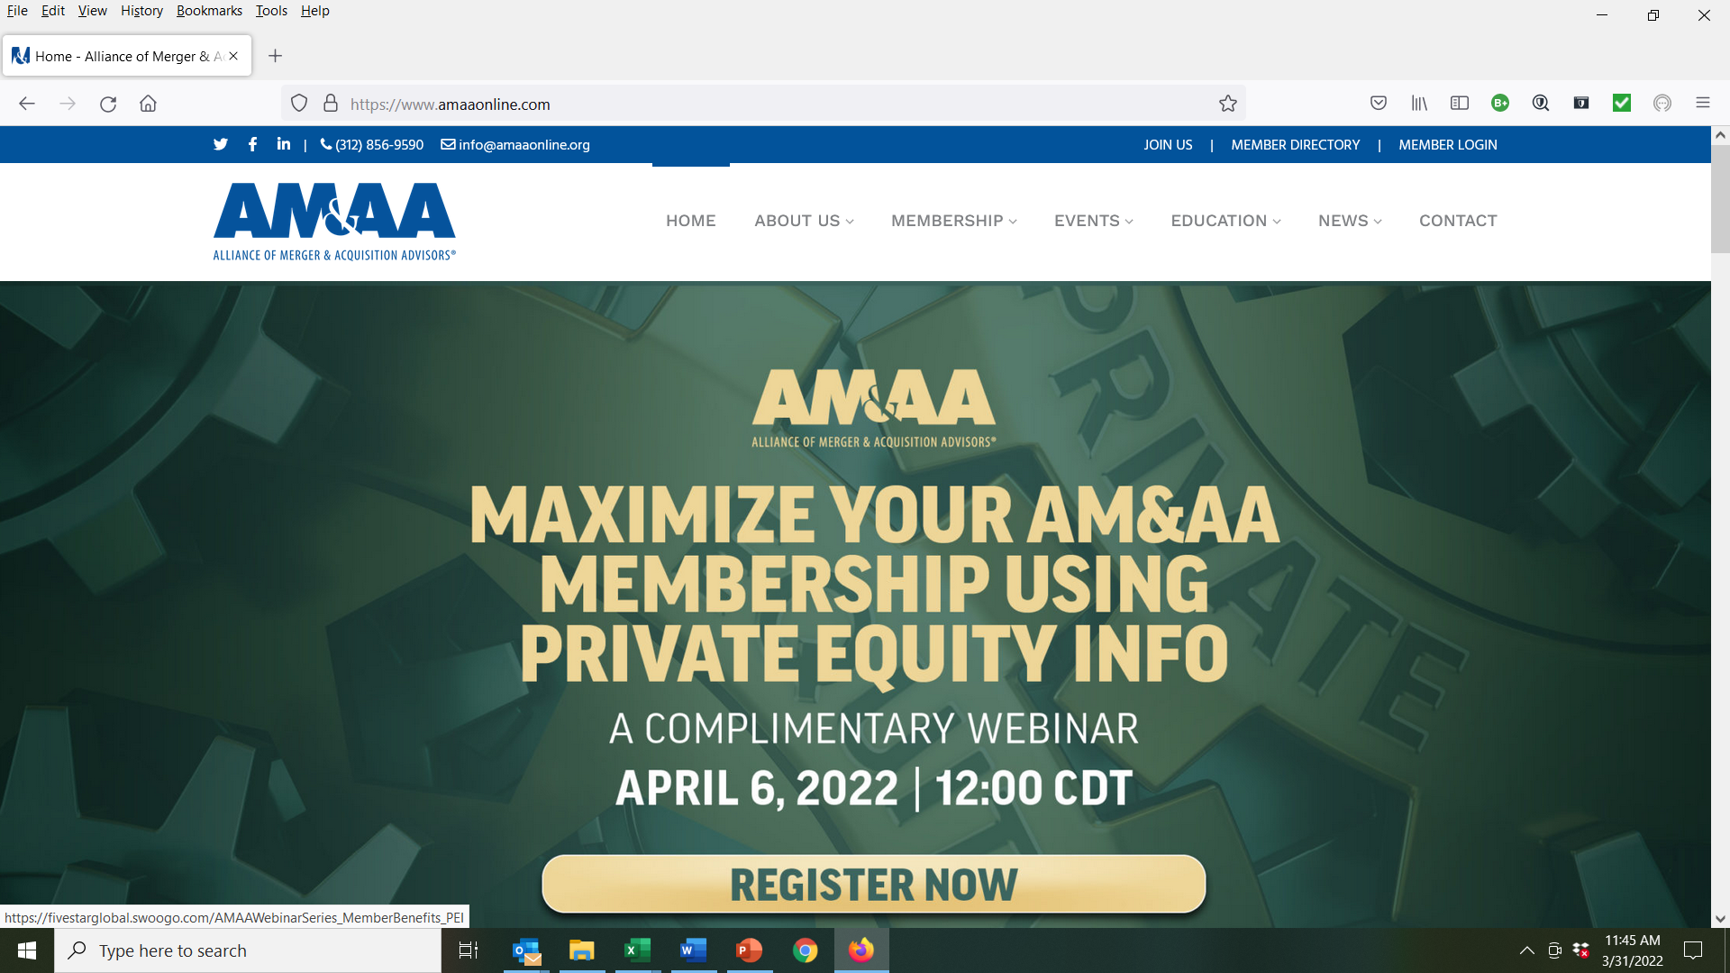
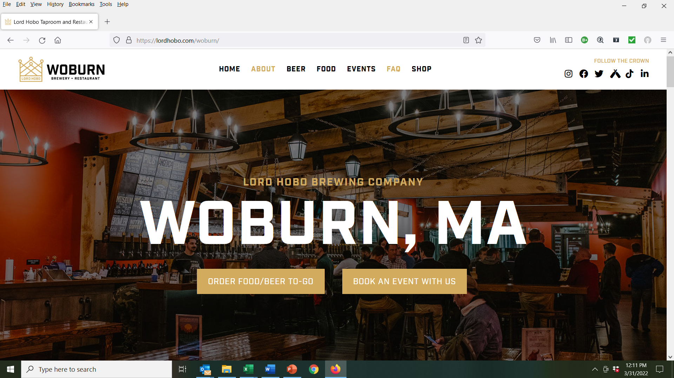
Cordially invite you to the Joint Spring Fling at:
L O R D H O B O B R E W I N G C o
When:
Tuesday, May 31, 2022 from 4:30-7:00 PM
What:
Includes one ticket for Lord Hobo beer, wine or soft drink plus an assortment of Tap Room appetizers
Who:
XPX and AM&AA Members: $45
Guests/Non-Members: $75

