Slide 1
Survey Results
XPX Emerging Professionals
January, 2021

Slide 2
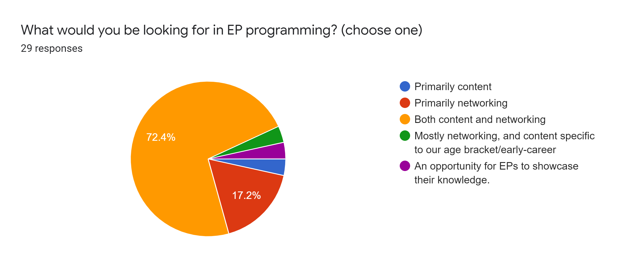

Slide 3
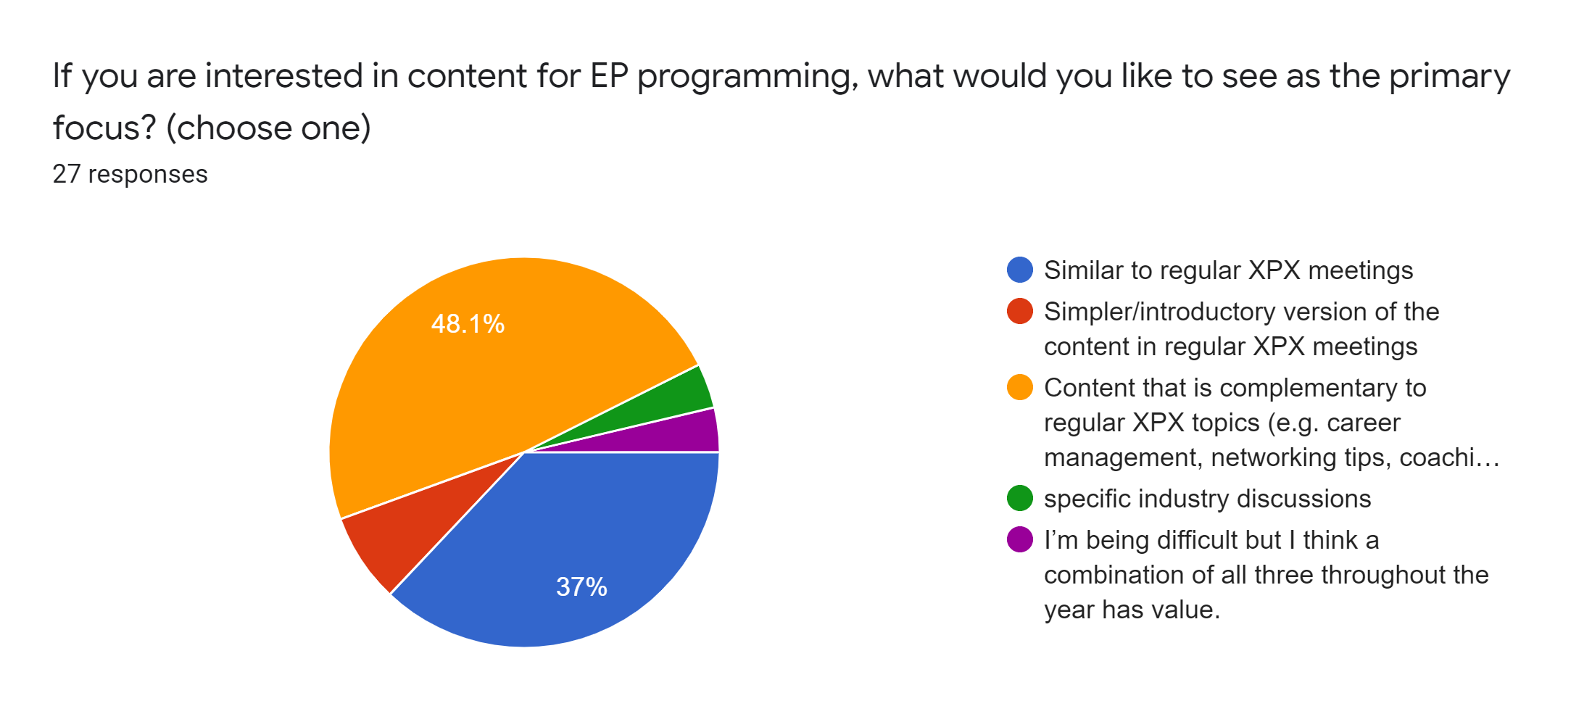

Slide 4
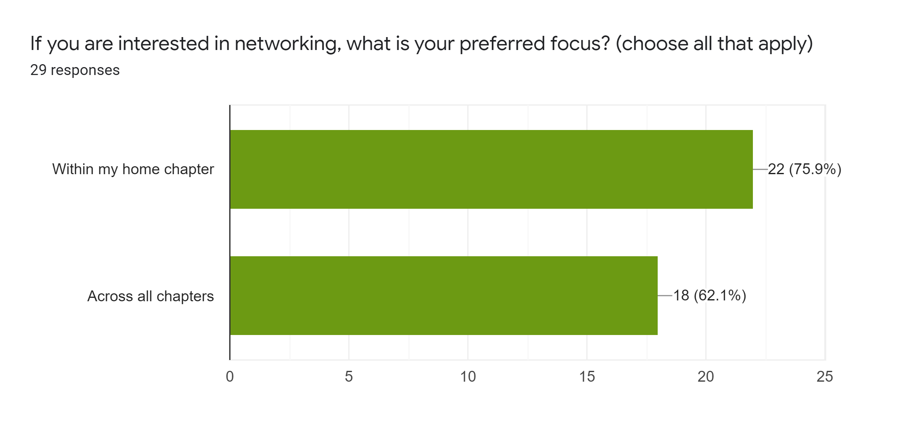

Slide 5
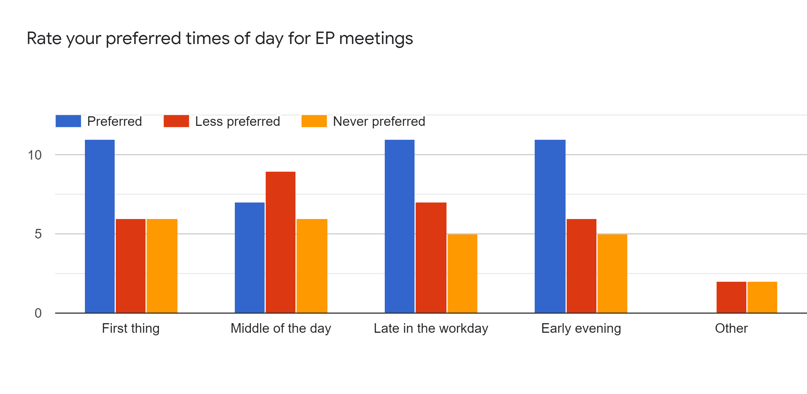

Slide 6
Anything else we should have asked or you would like to suggest? How can XPX serve you as an emerging professional?
plug and play marketing materials
Networking opportunities
I joined during COVID environment, so I have only known the virtual networking / Power of 5 sessions, which have been fantastic.
small group in person meetings maintaining social distance & masks
I prefer virtual events.

Slide 7
Existing Committee Chairs/Members
Chicago Laura Liss
Chicago Max Kopytko
Chicago Nermin Avdic
DC Metro Matthew Haskin
Fairfield County Anthony Macaluso
Maryland Erik Moore
New Jersey Marilyn Garcia
New York Allie Flood
New York Kevin Kettell
Philadelphia John Mesko
Philadelphia Theodore Passyn
New England Leland Mindnich
New England Jeff Rolke

Slide 8
New volunteers
At Large Karin Foster
Atlanta Roxann Smithers
Atlanta Greg Harper
Chicago Luke Rossi
Hartford David Fasi
Hartford, CT Xavier Lederer
Maryland Alan Alfano
New York Matt Foreman
New York Jonathan Sirota
San Antonio Lisa Mochel
Tri State - based in NJ, Jonathan Bookbinder

